Slide 1
Sprint 2: RSNA-MICCAI Brain Tumor Radiogenomic Classification
Rahaf’s part
Team Members:
Rahaf Alharbey
Jiawei Zhao
Shuyi Fan
Zhaowen Zhou

Slide 2
Rahaf’s part
Contents
Product Mission
Product Architecture
Technology Selection and Justification
Product Functions

Slide 3
This slide will be deleted in final version, just used as pointer
Contents
Product Mission
Architecture (same format as Technologies part in Sprint 1, both talking about the framework, but this time we should talk about the framework that could be executable)
Technology Selection and justification
Functional Functions (executable function of our product as well as user stories)

Slide 4
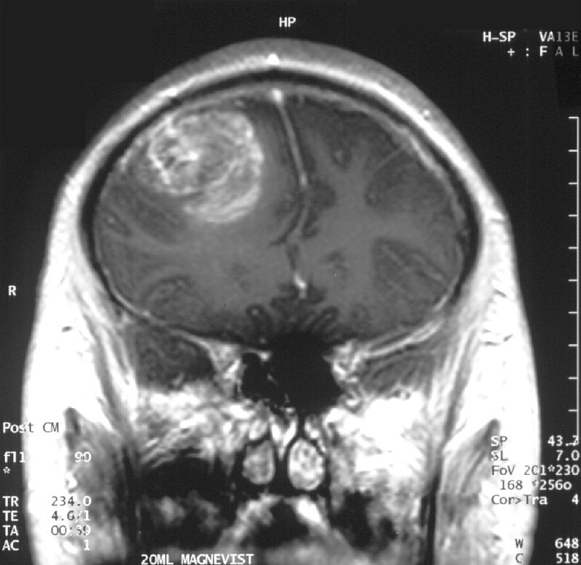
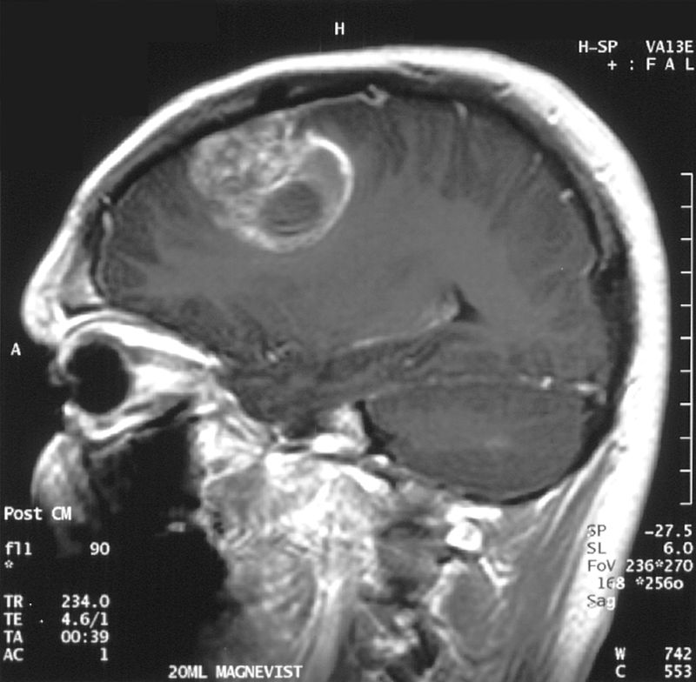
Background
Rahaf’s part
Glioblastoma (GMB) is both the most common form of brain cancer and the one with the worst prognosis.
MGMT promoter methylation (DNA sequence) has been shown to be a strong predictor of GMB.
MRI sagittal view, post contrast. 15 year old boy.

Slide 5
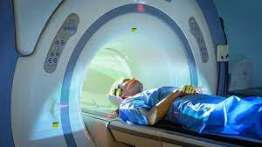
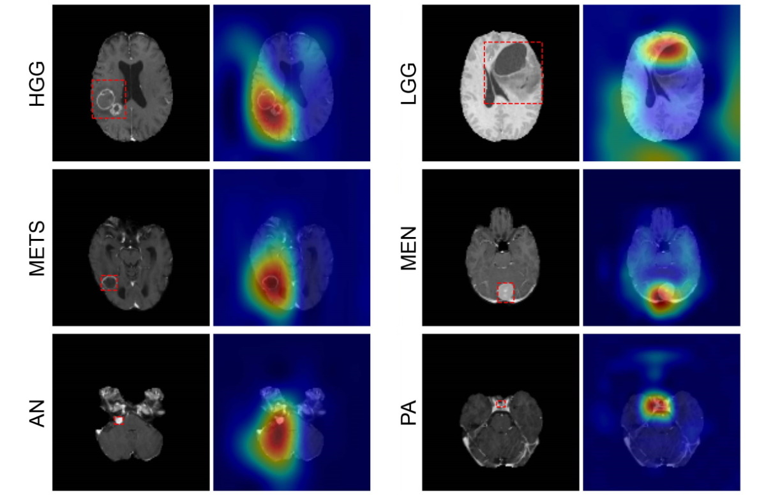
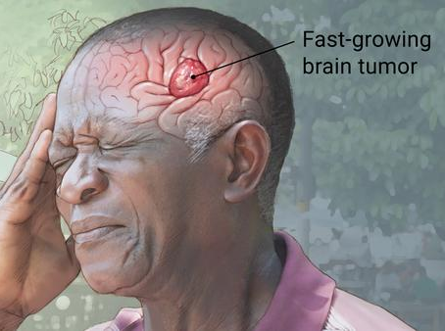
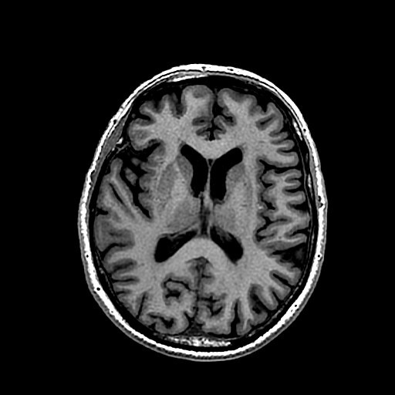
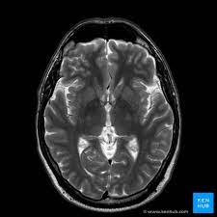
Product Mission
Rahaf’s part
Predicting GMB :
Using MRI (magnetic resonance imaging) scans to train and test our model to detect for the presence of MGMT promoter methylation.
Notes:
glioblastoma, it's both the most common form of brain cancer in adults and the one with the worst prognosis, with median survival being less than a year. The presence of a specific genetic sequence in the tumor known as MGMT promoter methylation has been shown to be a favorable prognostic factor and a strong predictor of responsiveness to chemotherapy.

Slide 6
Architecture
Y
Positive methylation status
Value = 1
Methylation beta value > threshold?
Methylation data
Site selection
Negative methylation status
Value = 0
N
Label selection
T1/T2/Flair axial
Filter out noise image
Slices selection
Slices rotation
MRI data

Slide 7
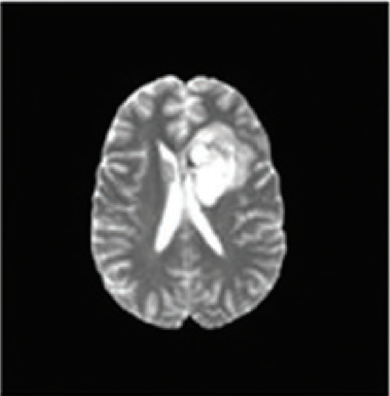
Architecture
Batch
Norm
Conv
Pool
Bi-directional GRU
Softmax
Input
ReLU
Dropout
ReLU
Dropout

Slide 8
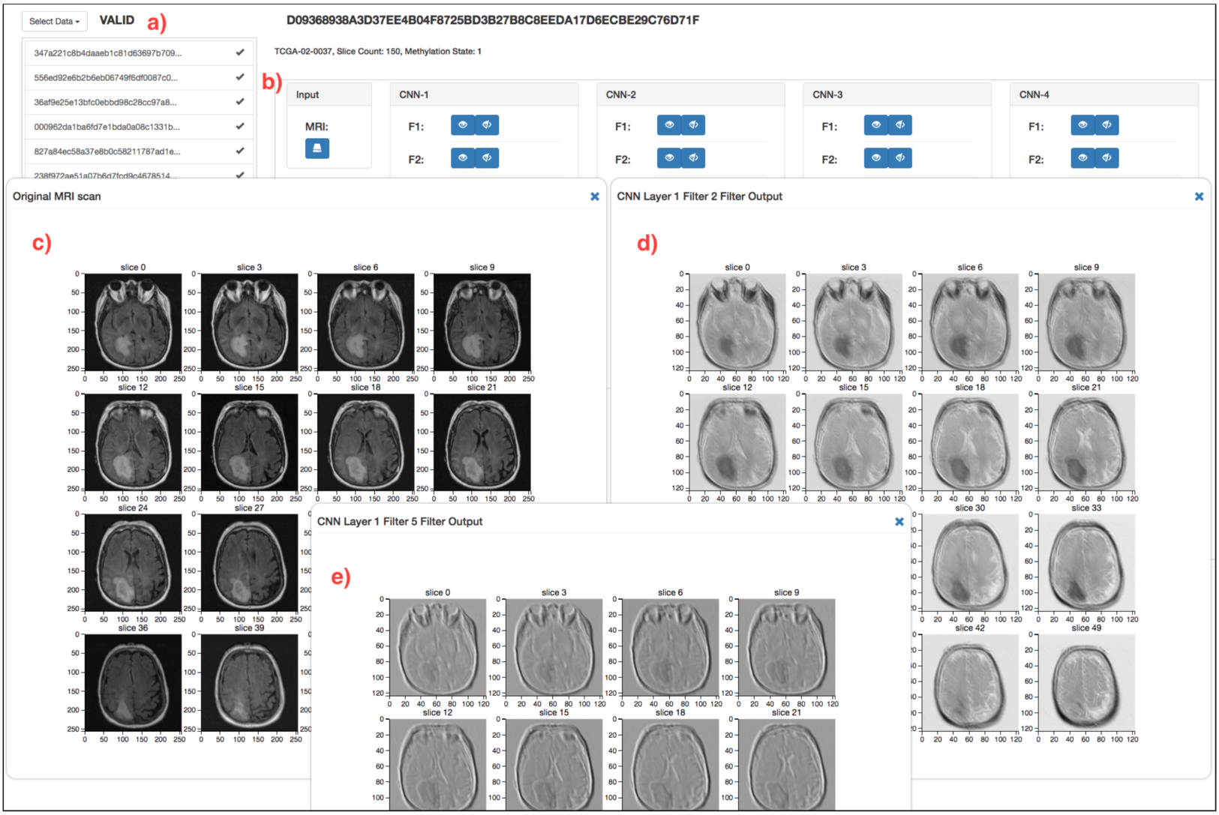
Technology
(a) Input the MRI scan (b) Show the steps of RCNN
(c) the output from any filter, in each convolutional layer
(d, e) the output after ReLU activation

Slide 9
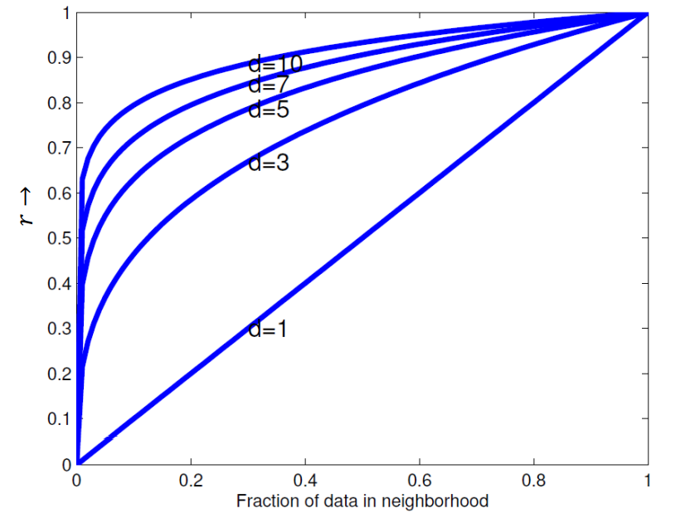
KNN is not suitable for processing high-dimensional data
Need to travel far to get the data points
These points are non-local points and not good predictors.
However in high-dimensional space, most points are far away to each other

Slide 10
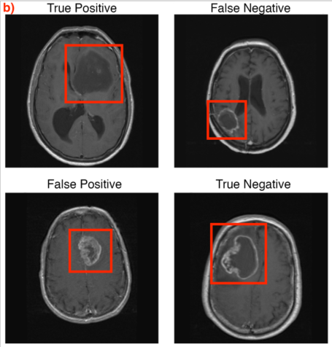
Justification
Precision | 0.72
Recall | 0.42

Slide 11
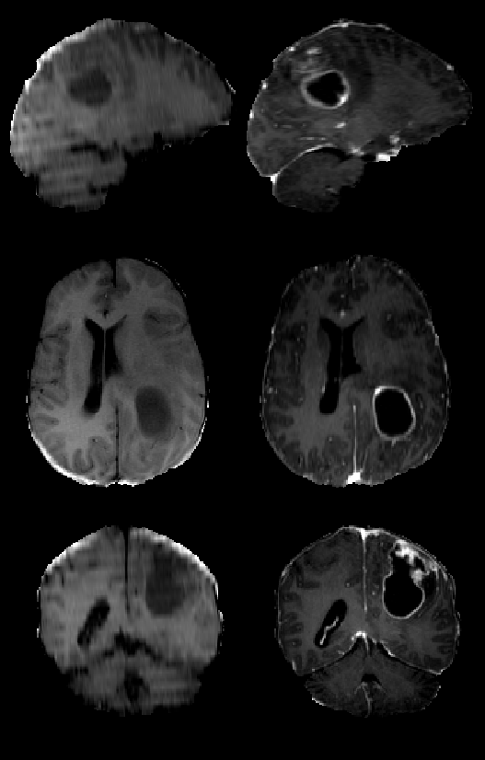
Rahaf’s part
User Story
A doctor who has already got the MRI scans, and want to know whether if patients have glioblastoma tumor or not, because this would potentially minimize the number of surgeries and refine the type of therapy required.
four sub-folders of MRI scans
Notes:
four sub-folders
Fluid Attenuated Inversion Recovery (FLAIR)
T1-weighted pre-contrast (T1w)
T1-weighted post-contrast (T1Gd)
T2-weighted (T2)

Slide 12

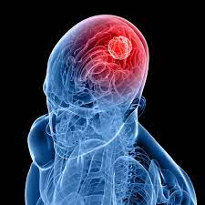
Rahaf’s part
Product Functions
② classifying progress,
hidden to users
③ output result:
GMB or not
① input four sub-folders of MRI scans
Notes:
four sub-folders
Fluid Attenuated Inversion Recovery (FLAIR)
T1-weighted pre-contrast (T1w)
T1-weighted post-contrast (T1Gd)
T2-weighted (T2)

Slide 13
Rahaf’s part
Thank you

